Slide 1
Virtual town hall Meeting
April 4, 2023

Slide 2



Housekeeping
Recording
How to participate
For Tech Support
Today’s Virtual Town Hall Meeting is being recorded
Video/mics will remain off during the presentation
Use the Q & A
At the end, we will open for live questions. You may “raise hand” to ask to unmute
Captions are available
For technical support, please contact Martin McIntosh at 949-294-3781
Notes:
Justin

Slide 3
Today’s Presenters
Nem Ochoa
General Manager
James Lee
Dir. Finance & Admin.
Justin Glover
Communications LAB
Christy Colby
Reg. & Pub. Aff. Mgr.
Brook Yared
Dir. Engineering & Op.
Notes:
Justin
Identify presenters
“Now I’d like to welcome Nem Ochoa for a welcome message”
After welcome message
“Now I’d like to welcome James Lee to give our presentation”

Slide 4
Agenda
Why we’re here
Who we are and what we do
Financial Challenges
Plan for the future
Next Steps
Q&A
Notes:
James
Hello and welcome

Slide 5
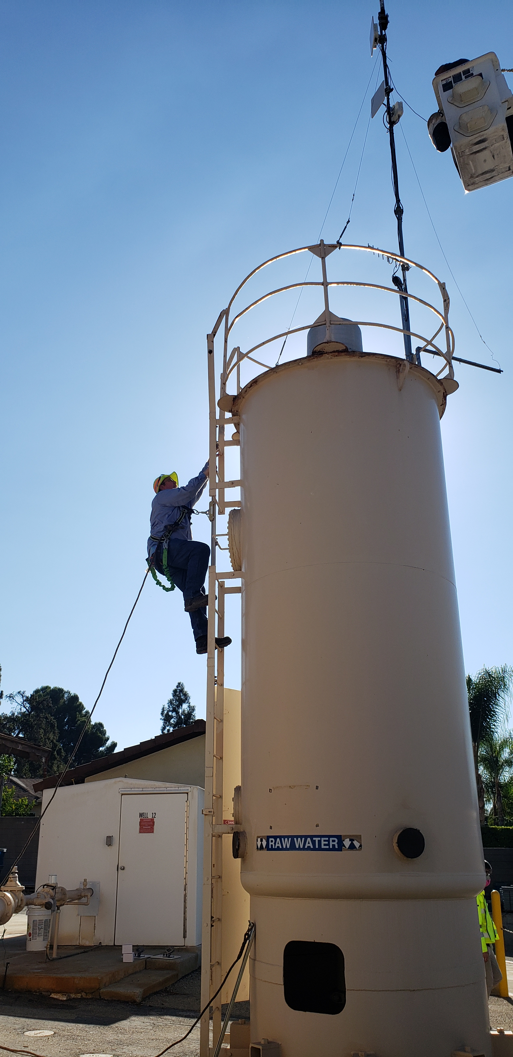
Why we’re here
To address rising costs to provide water and sewer service, as well as the need to replace aging infrastructure, we plan to propose a charge to be added to property rolls for property owners in our service area.
Notes:
To address rising costs to provide water and sewer service, as well as the need to replace aging infrastructure, we plan to propose a charge to be added to property rolls for property owners in our service area. Mention here that it’s going to be pipelines, specifically, and we’ll tackle the “why” later

Slide 6
Who we are and what we do

Slide 7
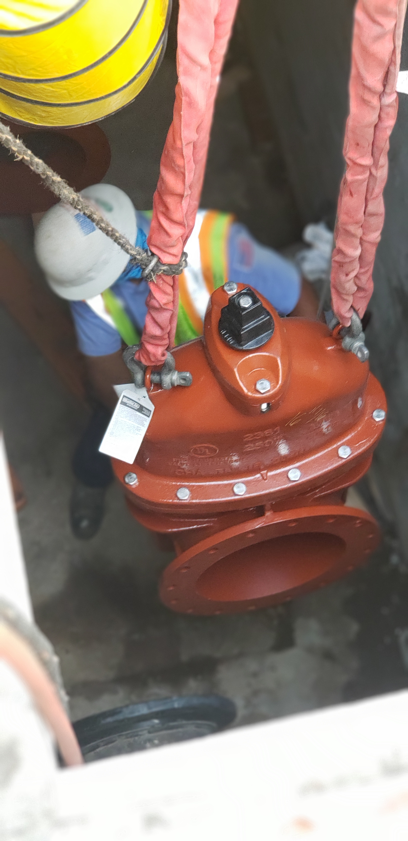
Mission and Vision
Mission
To provide quality water and wastewater services to the Crescenta Valley community in a dependable and economically responsible manner
Vision
Secure sustainable water supplies and ensure infrastructure reliability, while furthering our commitment to accountability, transparency, and cost-effectiveness
Notes:
Introduce “simple” mission of providing reliable and safe water service while being fiscally responsible (stewards of both public funds and public health and safety).
We are guided by our mission and vision. These are but simple statements, but the entirety of our efforts are captured by these statements

Slide 8
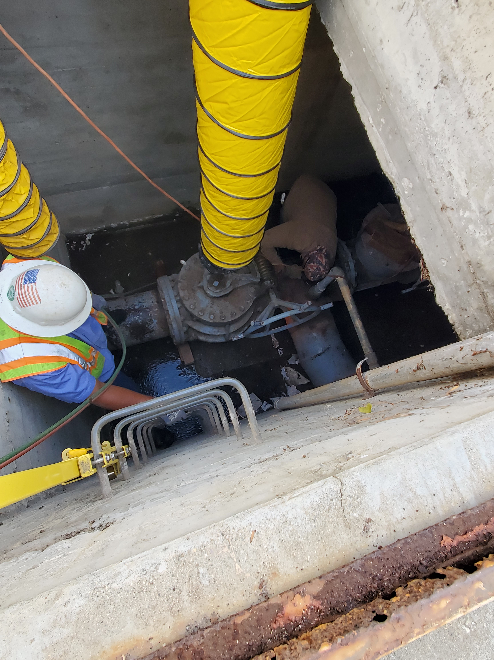
Strategic Plan Update
Goal – Reliable Water & Wastewater Service
Ensure infrastructure reliability and performance
Goal – Fiscal Responsibility
Improve financial stability

Slide 9
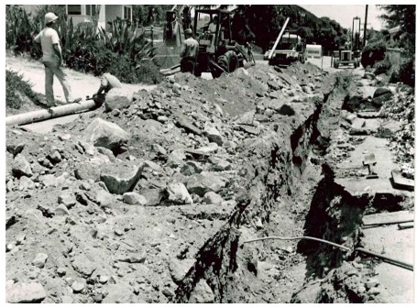
History
Notes:
History of Crescenta Valley Water District
Started in 1895 as local water companies in the area
By 1950, incorporated as a “County Water District”
La Crescenta Water Company
Dunsmore Canyon Water Company
Sierra Verdugo Water Company
Cresta Heights Mutual Water Company
Highway Highlands Water Company
Mountain Water Company
Crescenta Mutual Water Company
Expanded in 1979 with the installation of the sewer collection system

Slide 10
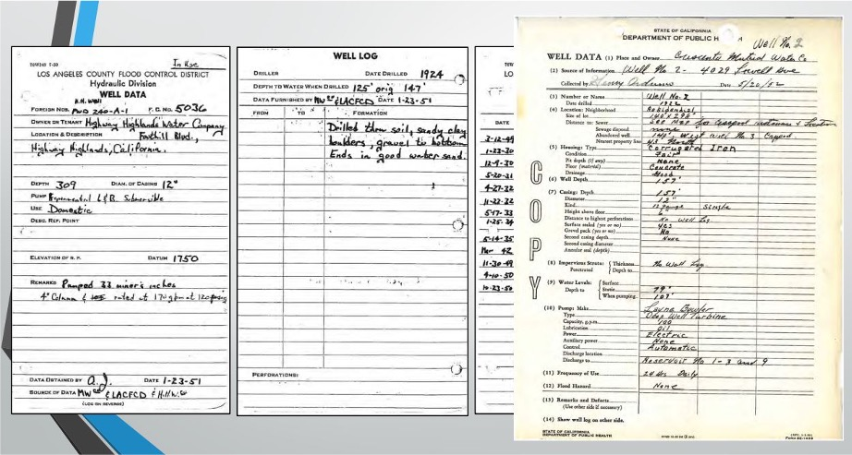
Notes:
Cool records to share

Slide 11
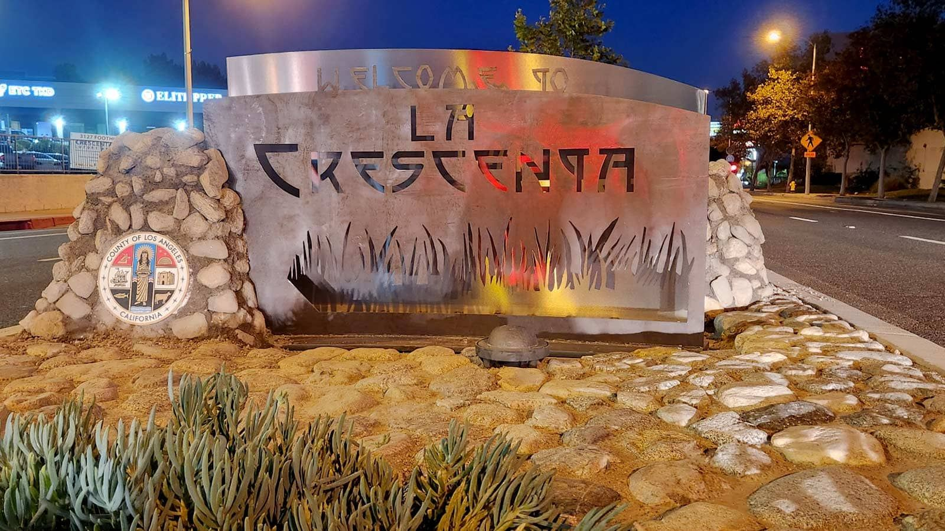
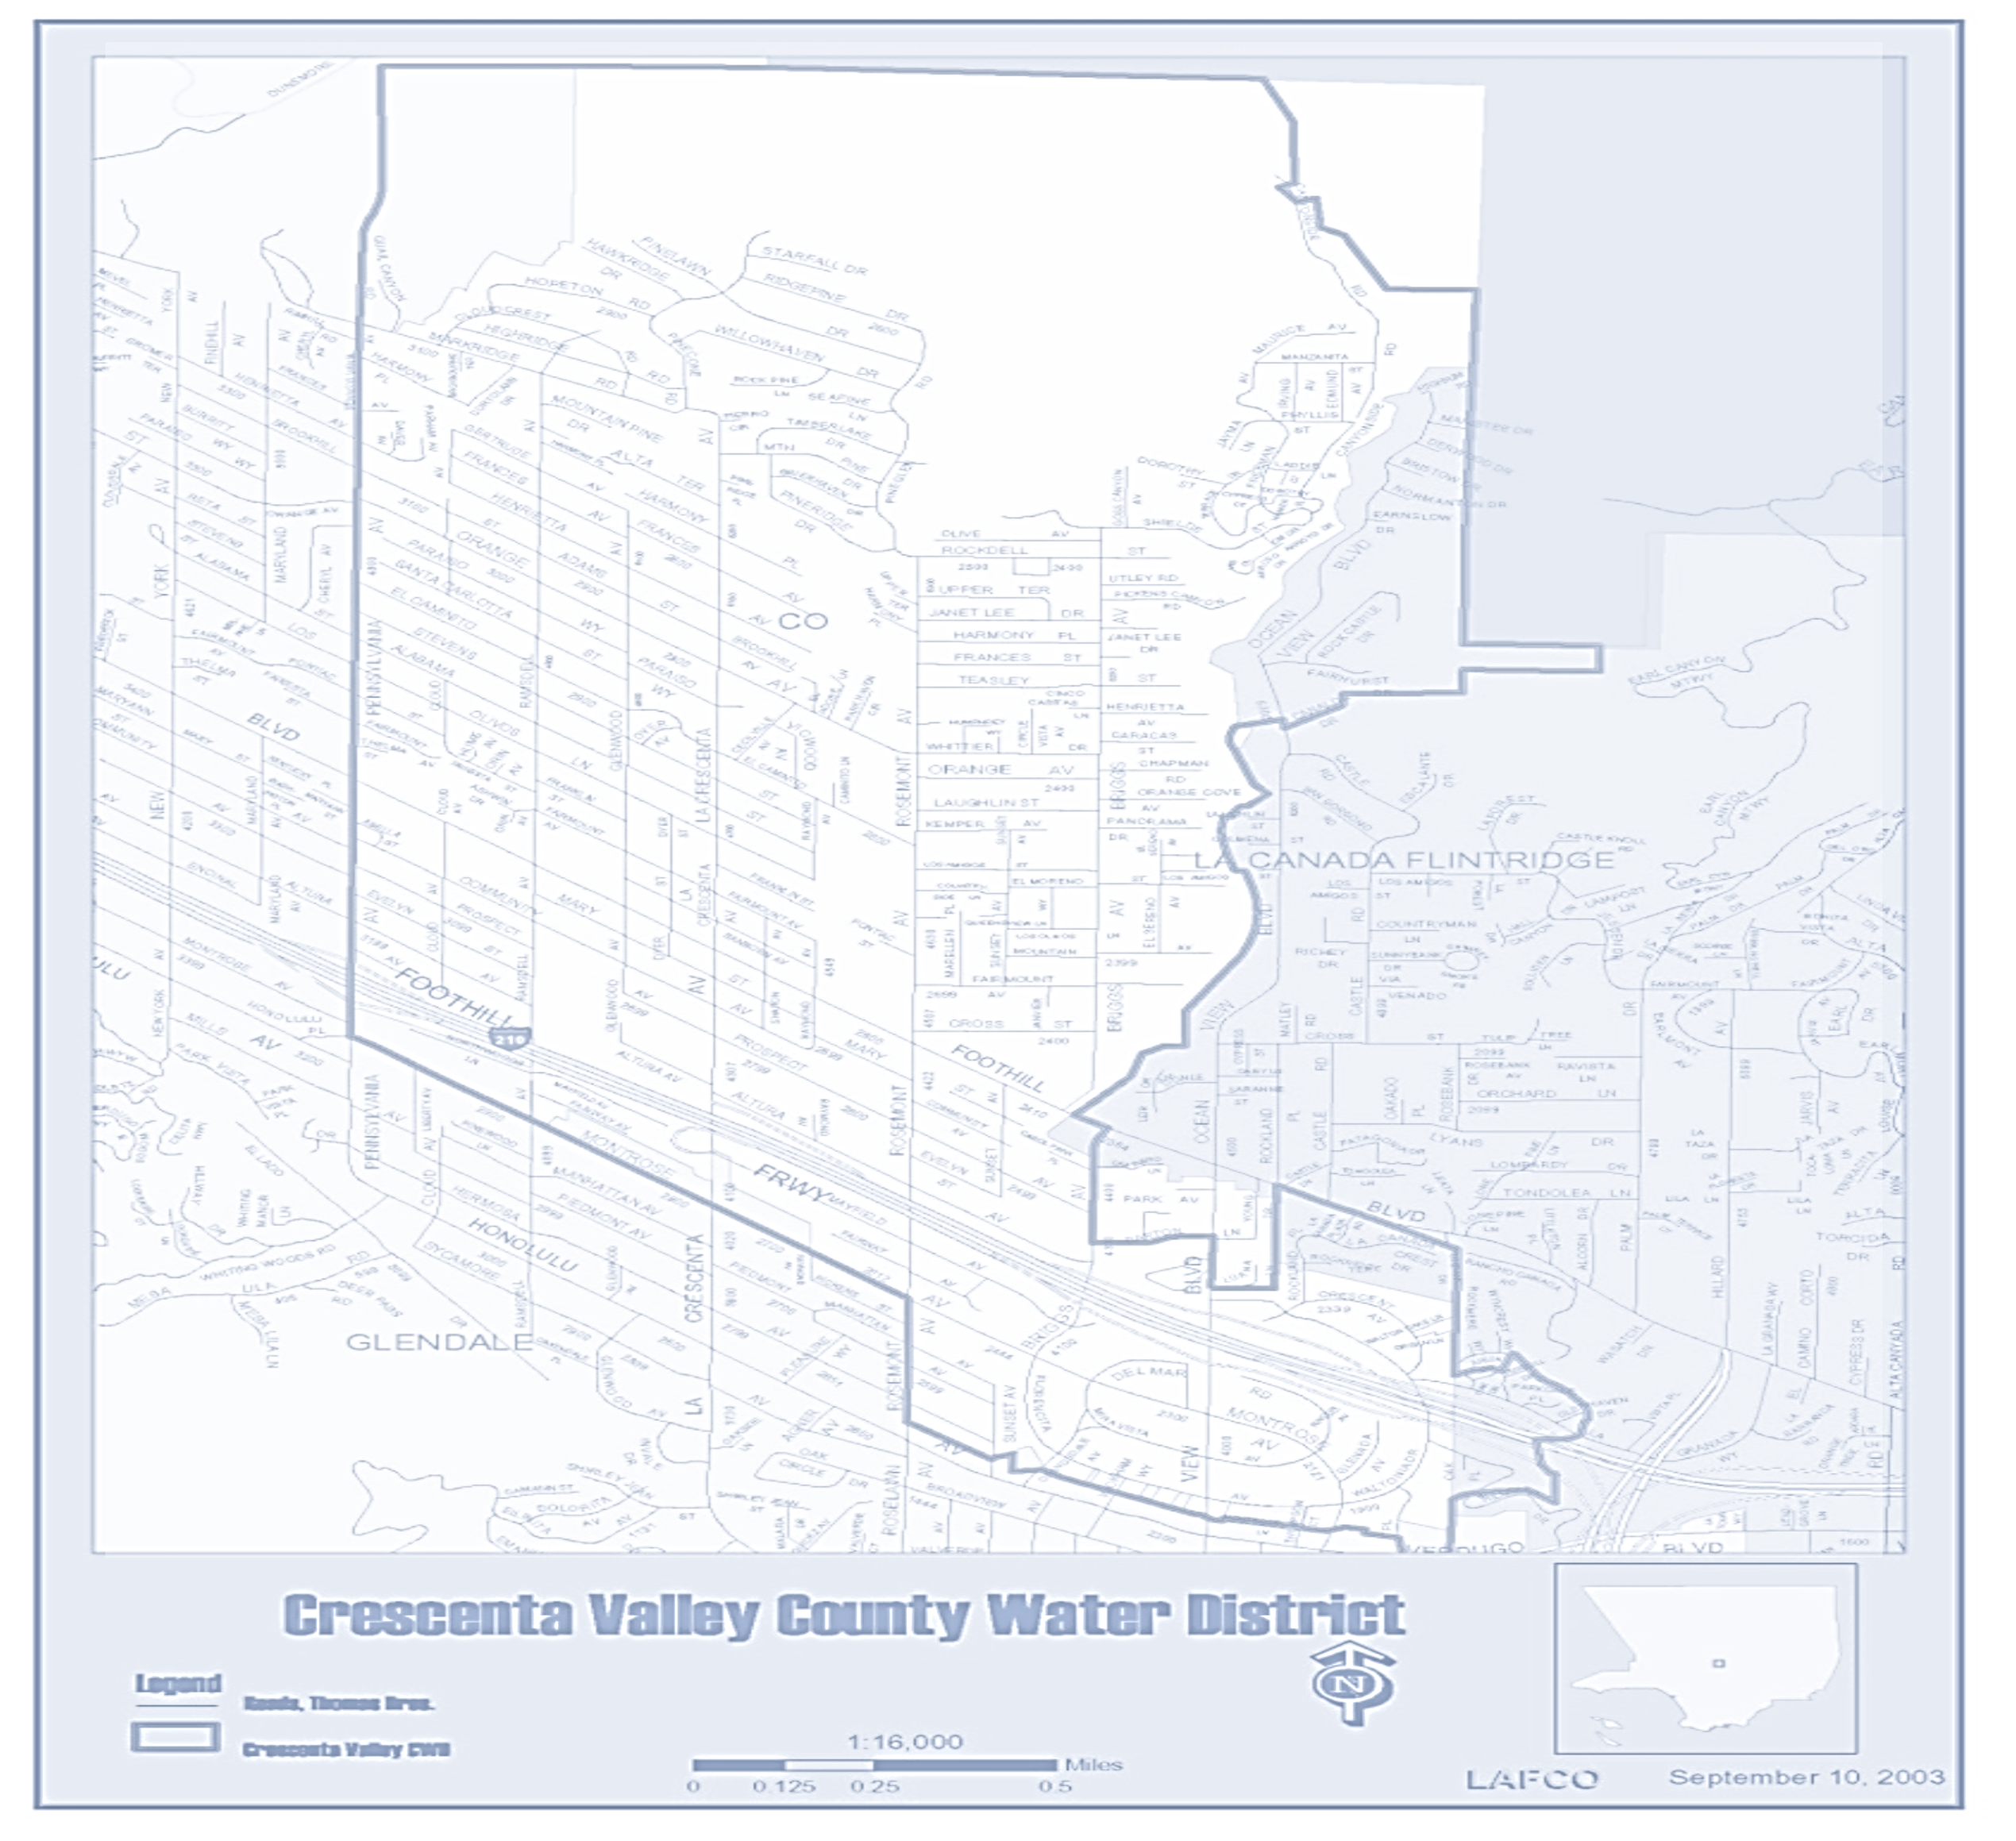
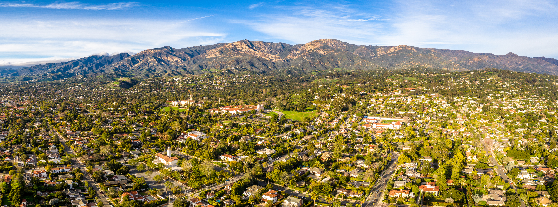
CVWD Today
Notes:
Basic Assets & Operations
Goal(s) of section
Appreciation for scale, variety, and complexity of assets and operations
Water supply + water treatment
Groundwater
SWP
Colorado
Water storage
Water distribution
Pumps
SCADA
Pipelines
Emergency preparedness
Other (beyond scope of conversation) – customer service / field service / repairs / CIP development / community stewardship
Serves 36,000 residents
La Crescenta, Montrose, and portions of Glendale and La Canada Flintridge
Over 8,400 water and sewer connections
95 miles of water distribution pipelines
11 Pressure Zones with 2,000+ feet of elevation gain
34 Booster Pumps
17 Steel Tanks and Reservoirs with a capacity of 17.5 million gallons
Daily storage – 8-10 MG
5-7 day storage without water supply
Delivers over 1.3 billion gallons of water each year
85% of CVWD customers are residential or single-family homes
Water Supply
Water Treatment
Water Storage
Water Distribution
Emergency Preparedness
Support
Customer Service
Field Service and Repairs
Infrastructure Development
Community Stewardship

Slide 12
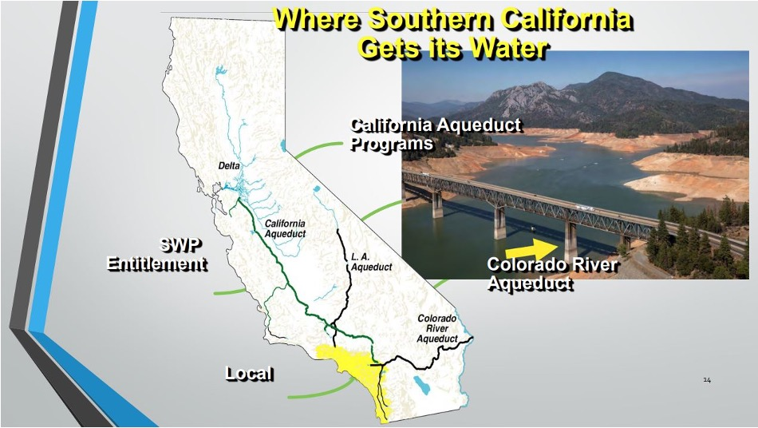
Water Supply
Notes:
Water Supply

Slide 13
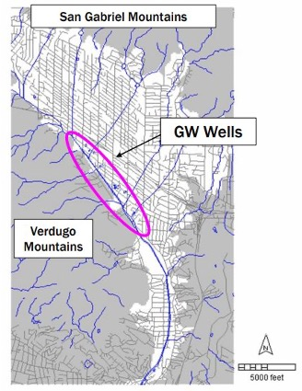
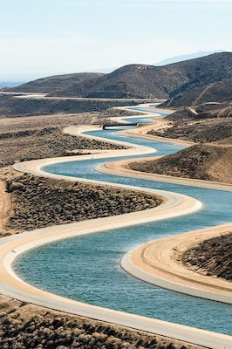
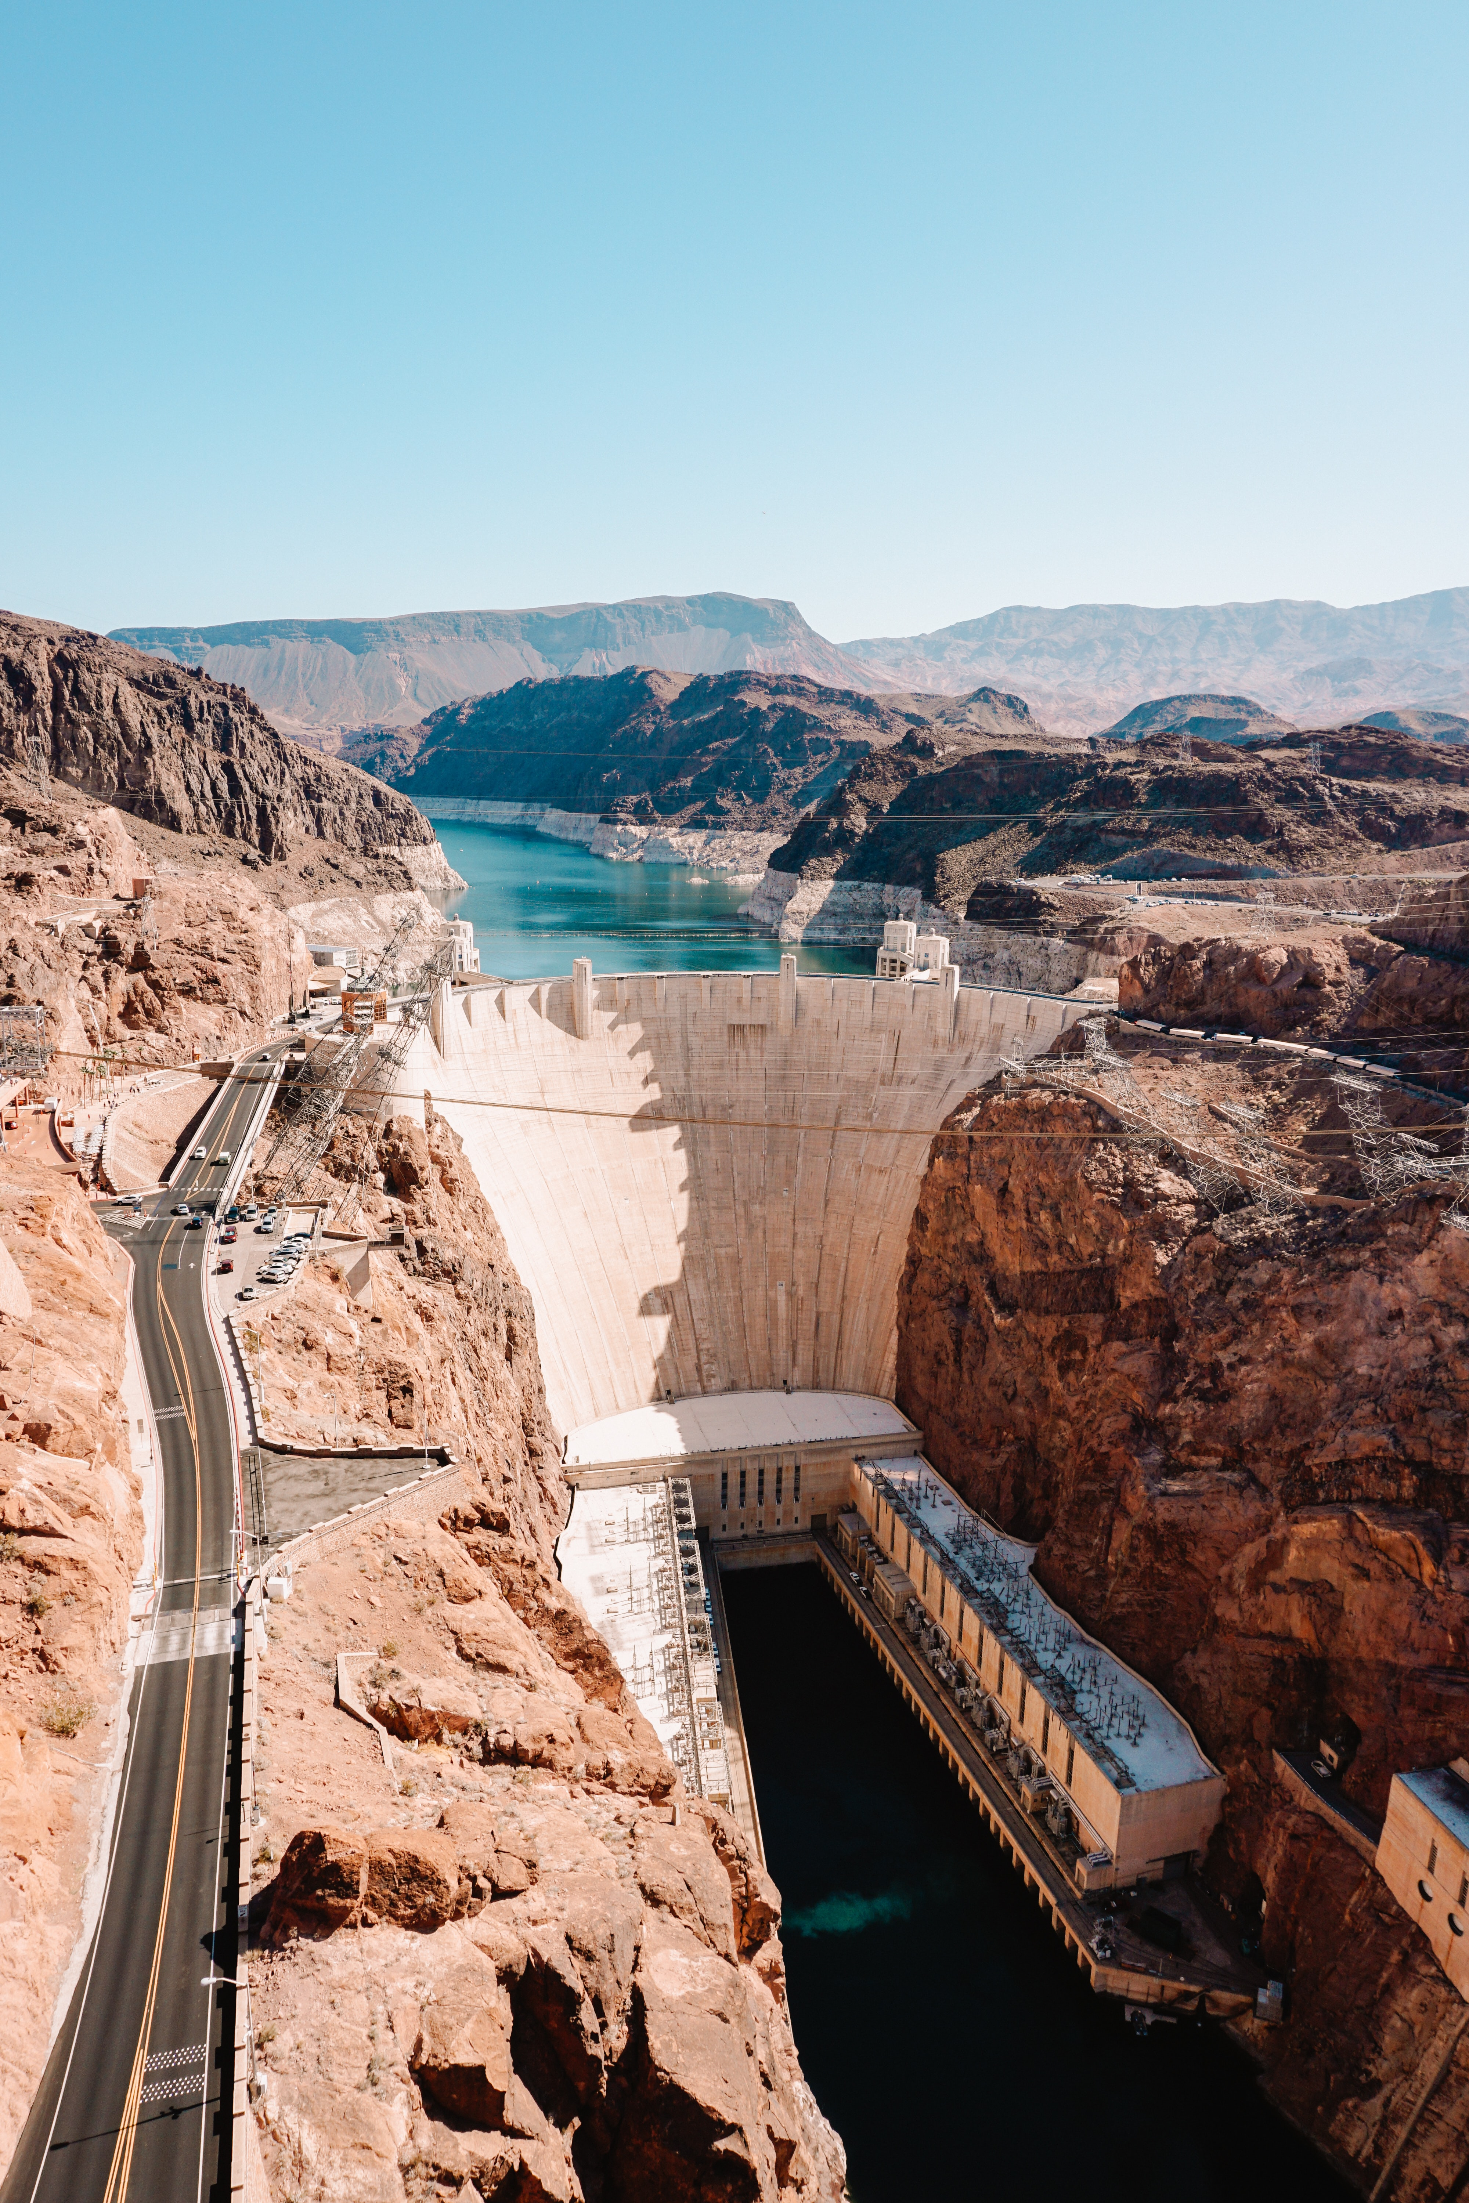
Water Supply
Notes:
Water Supply
Start with water supply (explain that we are going to review the Reader’s Digest version since this is not the focus of the presentation)
Sources: 1) groundwater (well pic + rainfall history); 2) State Water Project; 3) Colorado River
Summary graphic on next page

Slide 14
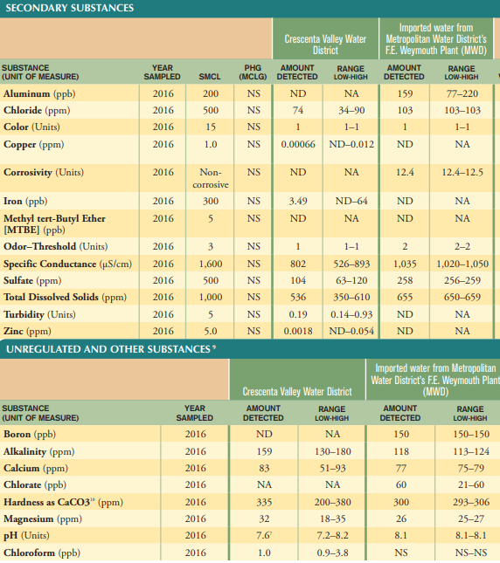
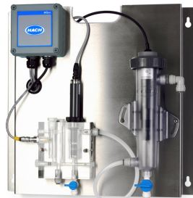
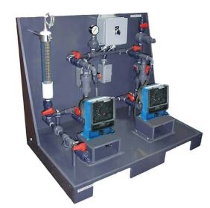
Water Treatment
Notes:
Water Treatment
This all needs to get treated, whether through chemicals or blending.
Plus rigorous testing and reporting requirements – pic of annual water quality report you all should get in the mail

Slide 15
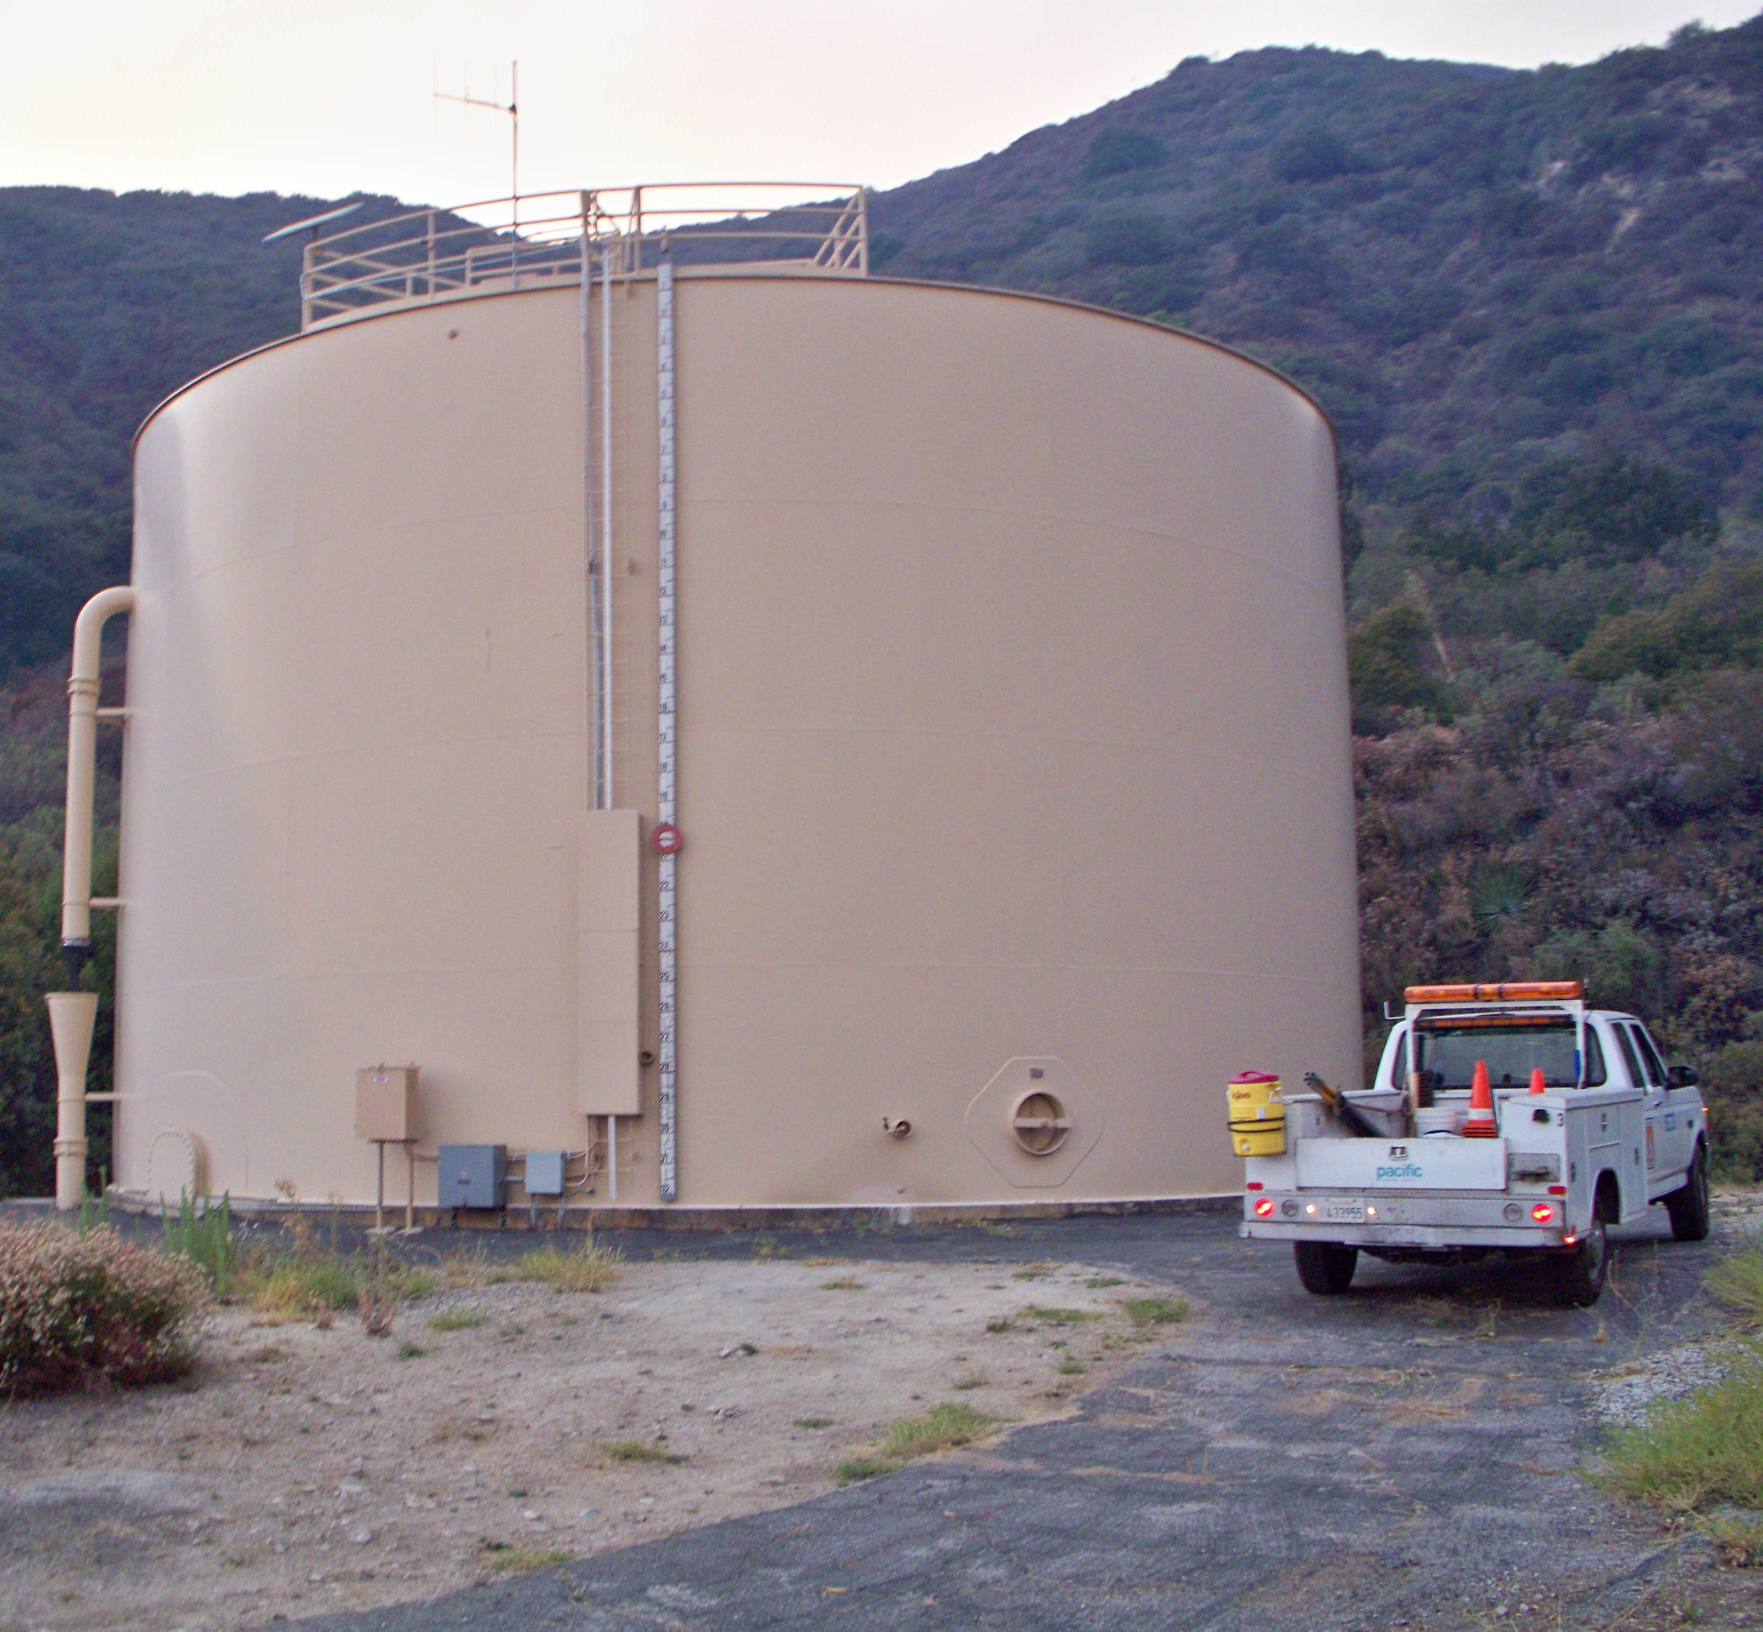
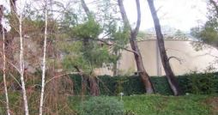
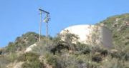
Water Storage
Notes:
Water Storage
CVWD’s water supply is pumped to and held in reservoirs located throughout the area
District maintains 17 reservoirs, constructed between 1949 and 1985 with storage capacity of 17.5 million gallons
14 steel and 3 concrete

Slide 16
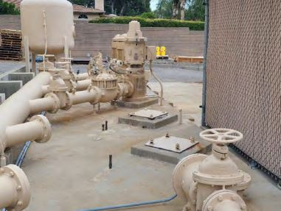
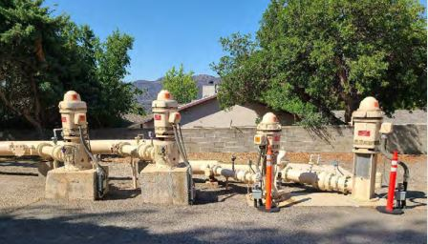
Water Distribution
Notes:
Water Distribution
The means by which water is pumped to reservoirs and then delivered to homes
Booster Pumps
34 booster pumps, with pressure ranging from 30 psi to 210 psi
SCADA System
“Brains” of the water distribution system
Pipelines – 95 miles of water mains and laterals to individual homes
Boosters - Cost of electricity is $850K per year
SCADA – brains of the system. Plant operators are available for standby 24/7 and are constantly monitoring water production, treatment, and distribution

Slide 17
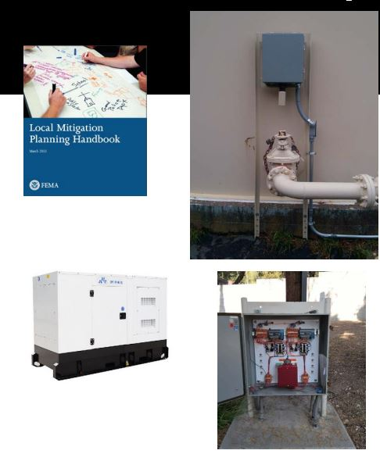
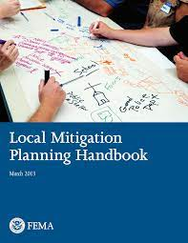
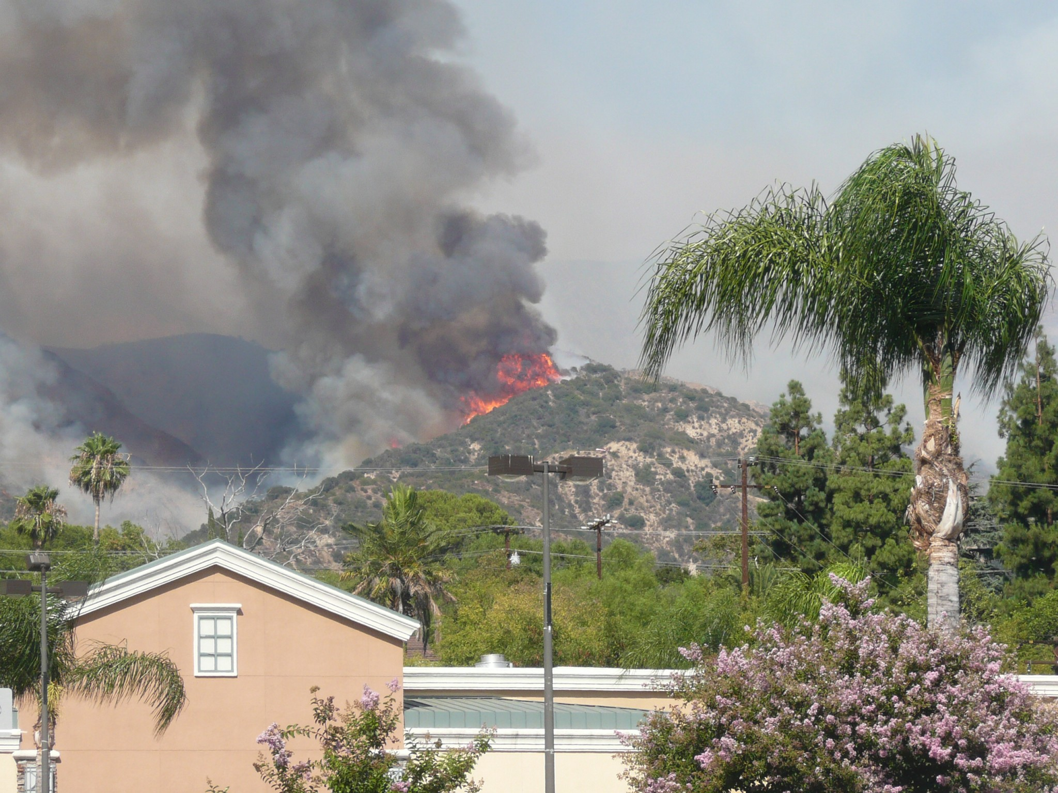
Emergency Preparedness
Notes:
Emergency Preparedness
Emergency Response is a responsibility of the District to the Crescenta Valley and neighboring communities
651 fire hydrants
10 sites have “seismic sensors”
Emergency generators – stationary and portable

Slide 18
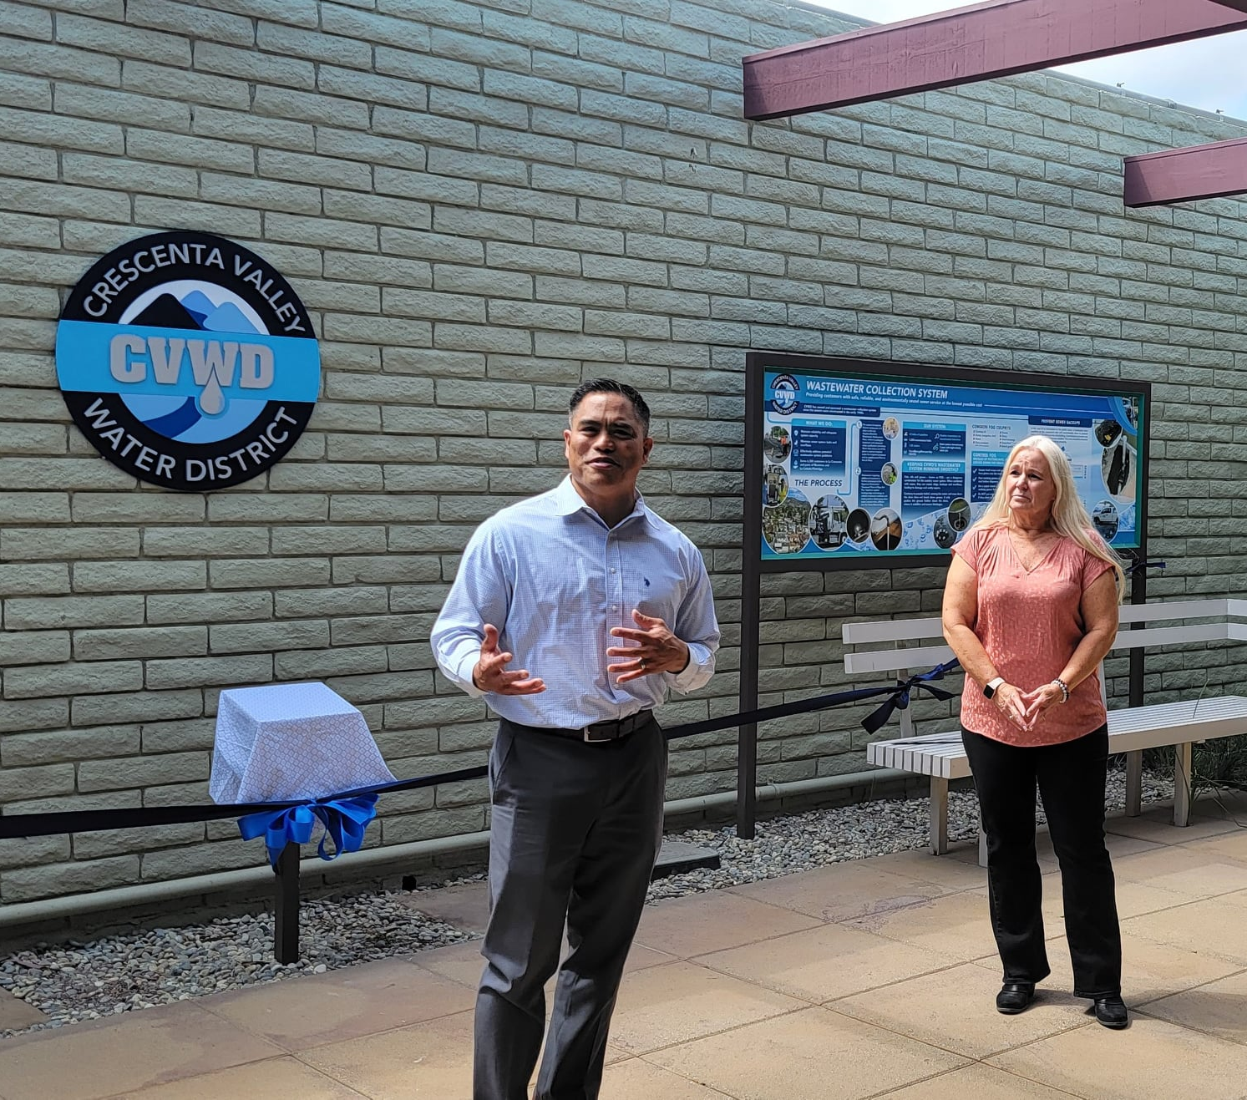
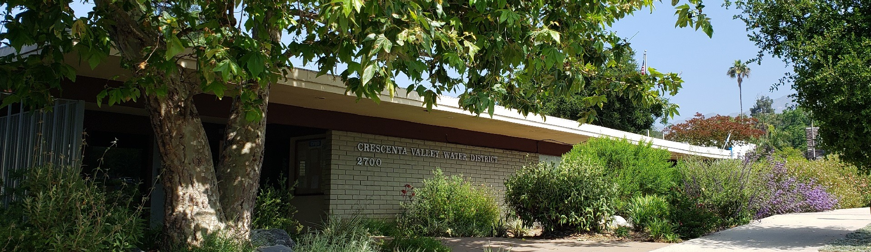
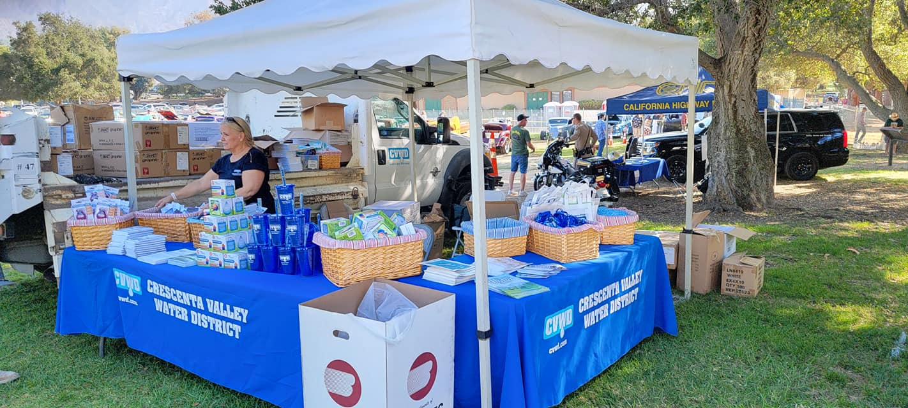
Customer Support
Notes:
Customer Support
We focused on getting water to your tap. There are a host of other efforts – customer service / long-term planning / community stewardship that go into the overall service you receive from the District
We will leave it there, as this is a whole discussion

Slide 19
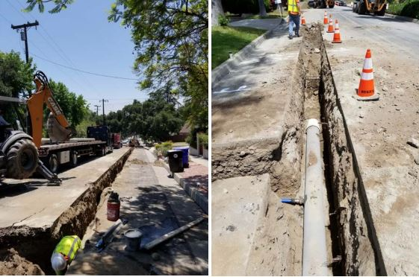
Focus on Pipelines
Notes:
Why Pipelines (The “why”, Part 1)
Goal(s) of section
Answer question of why focus on pipelines, specifically?
Pipelines are the backbone to the system. We could have all the water in the world treated to the highest standards
Without pipelines, homes are not being supplied water
Preserving the ability to maintain water service to homes preserve usefulness of the home and property values
Tying the benefit to the property is a more equitable approach (the cost is paid over time by each owner over time)
All of the system is tied together. It is important to maintain all endpoints as proactively as possible
Community equity – shared responsibility of infrastructure reliability to convey water to fight fires
Pipelines are the backbone to the system – we could have all the water in the world and treated to the highest standards
Without pipelines, homes are not being supplied with water
Preserving the ability to maintain water service to homes preserves the usefulness of the home and property values
Tying the benefit to the property is a more equitable approach (the cost is paid over time by each owner over time)
All of the system is tied together. It is important to maintain all endpoints proactively
Community equity – shared responsibility of infrastructure reliability to convey water to fight fires
Without conveyance, water is just a bunch of molecules. Might as well be individual gallon jugs from your local grocery store to your home.
“It has been well said that the wise man first buys the water then the land when he contemplates
establishing his lares and penates-or in plain words, begins home building, in California” – J.W. Wood,
Pasadena Citizen and Historian (1917)
In fact, it was the advent of electricity at the turn of the 20th century that made broader settlement possible. Both to pump the water out of the ground and then up the hill to, at that time, the various private water companies

Slide 20
Focus on Pipelines
Notes:
Recognized the immediacy of this critical need
Conducted studies to determine an infrastructure reliability plan
Pipe Age – Range from 90 years (1933) to new (2022)
51% of pipes are 50 years old
“Useful life” of pipe is 75 years
Conducted analyses and a series of workshops with the community and the Board over several years to develop a plan called the “Roadmap”, which develops and infrastructure reliability plan and an associated plan to fund it

Slide 21
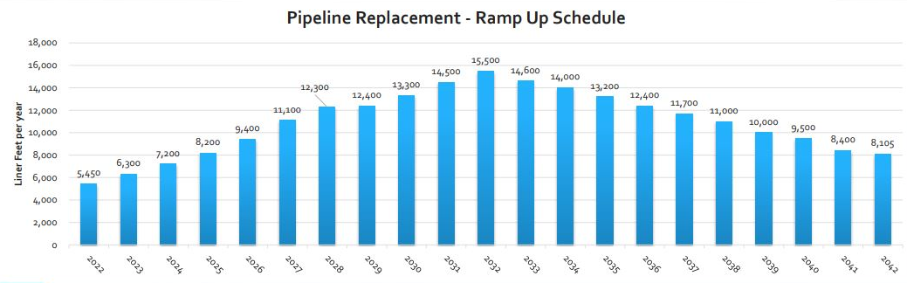
Focus on Pipelines
Notes:
Recognized the immediacy of this critical need
Conducted studies to determine an infrastructure reliability plan
Pipe Age – Range from 90 years (1933) to new (2022)
51% of pipes are 50 years old
“Useful life” of pipe is 75 years
Conducted analyses and a series of workshops with the community and the Board over several years to develop a plan called the “Roadmap”, which develops and infrastructure reliability plan and an associated plan to fund it
Developed the Infrastructure Funding and Reliability Roadmap (the “Roadmap”)
While the useful life of pipe is 75 years, the District was on pace for a 200-year plan. We developed a plan to get back on track to minimize 10x higher costs of reactive maintenance
We’ll come back to this, but let’s pause there

Slide 22
Financial challenges

Slide 23
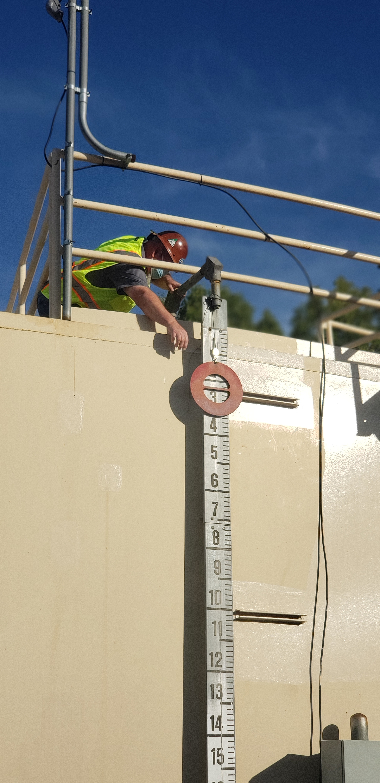
Challenges
Significant and sustained drought – 15%+ reduction in metered revenues
Historically high inflation
Pandemic
Significant increase in water cost
Heightened need to continue pipeline replacement program
  However, due to financial conditions, projects have been deferred
Notes:
Start with we did the hard thing – we raised rates to appropriately take this on.
Challenges
Significant and sustained drought – 15%+ reduction in metered revenues
Historically high inflation
Pandemic
Significant increase in water cost
Heightened need to continue pipeline replacement program
However, due to financial conditions, projects have been deferred

Slide 24
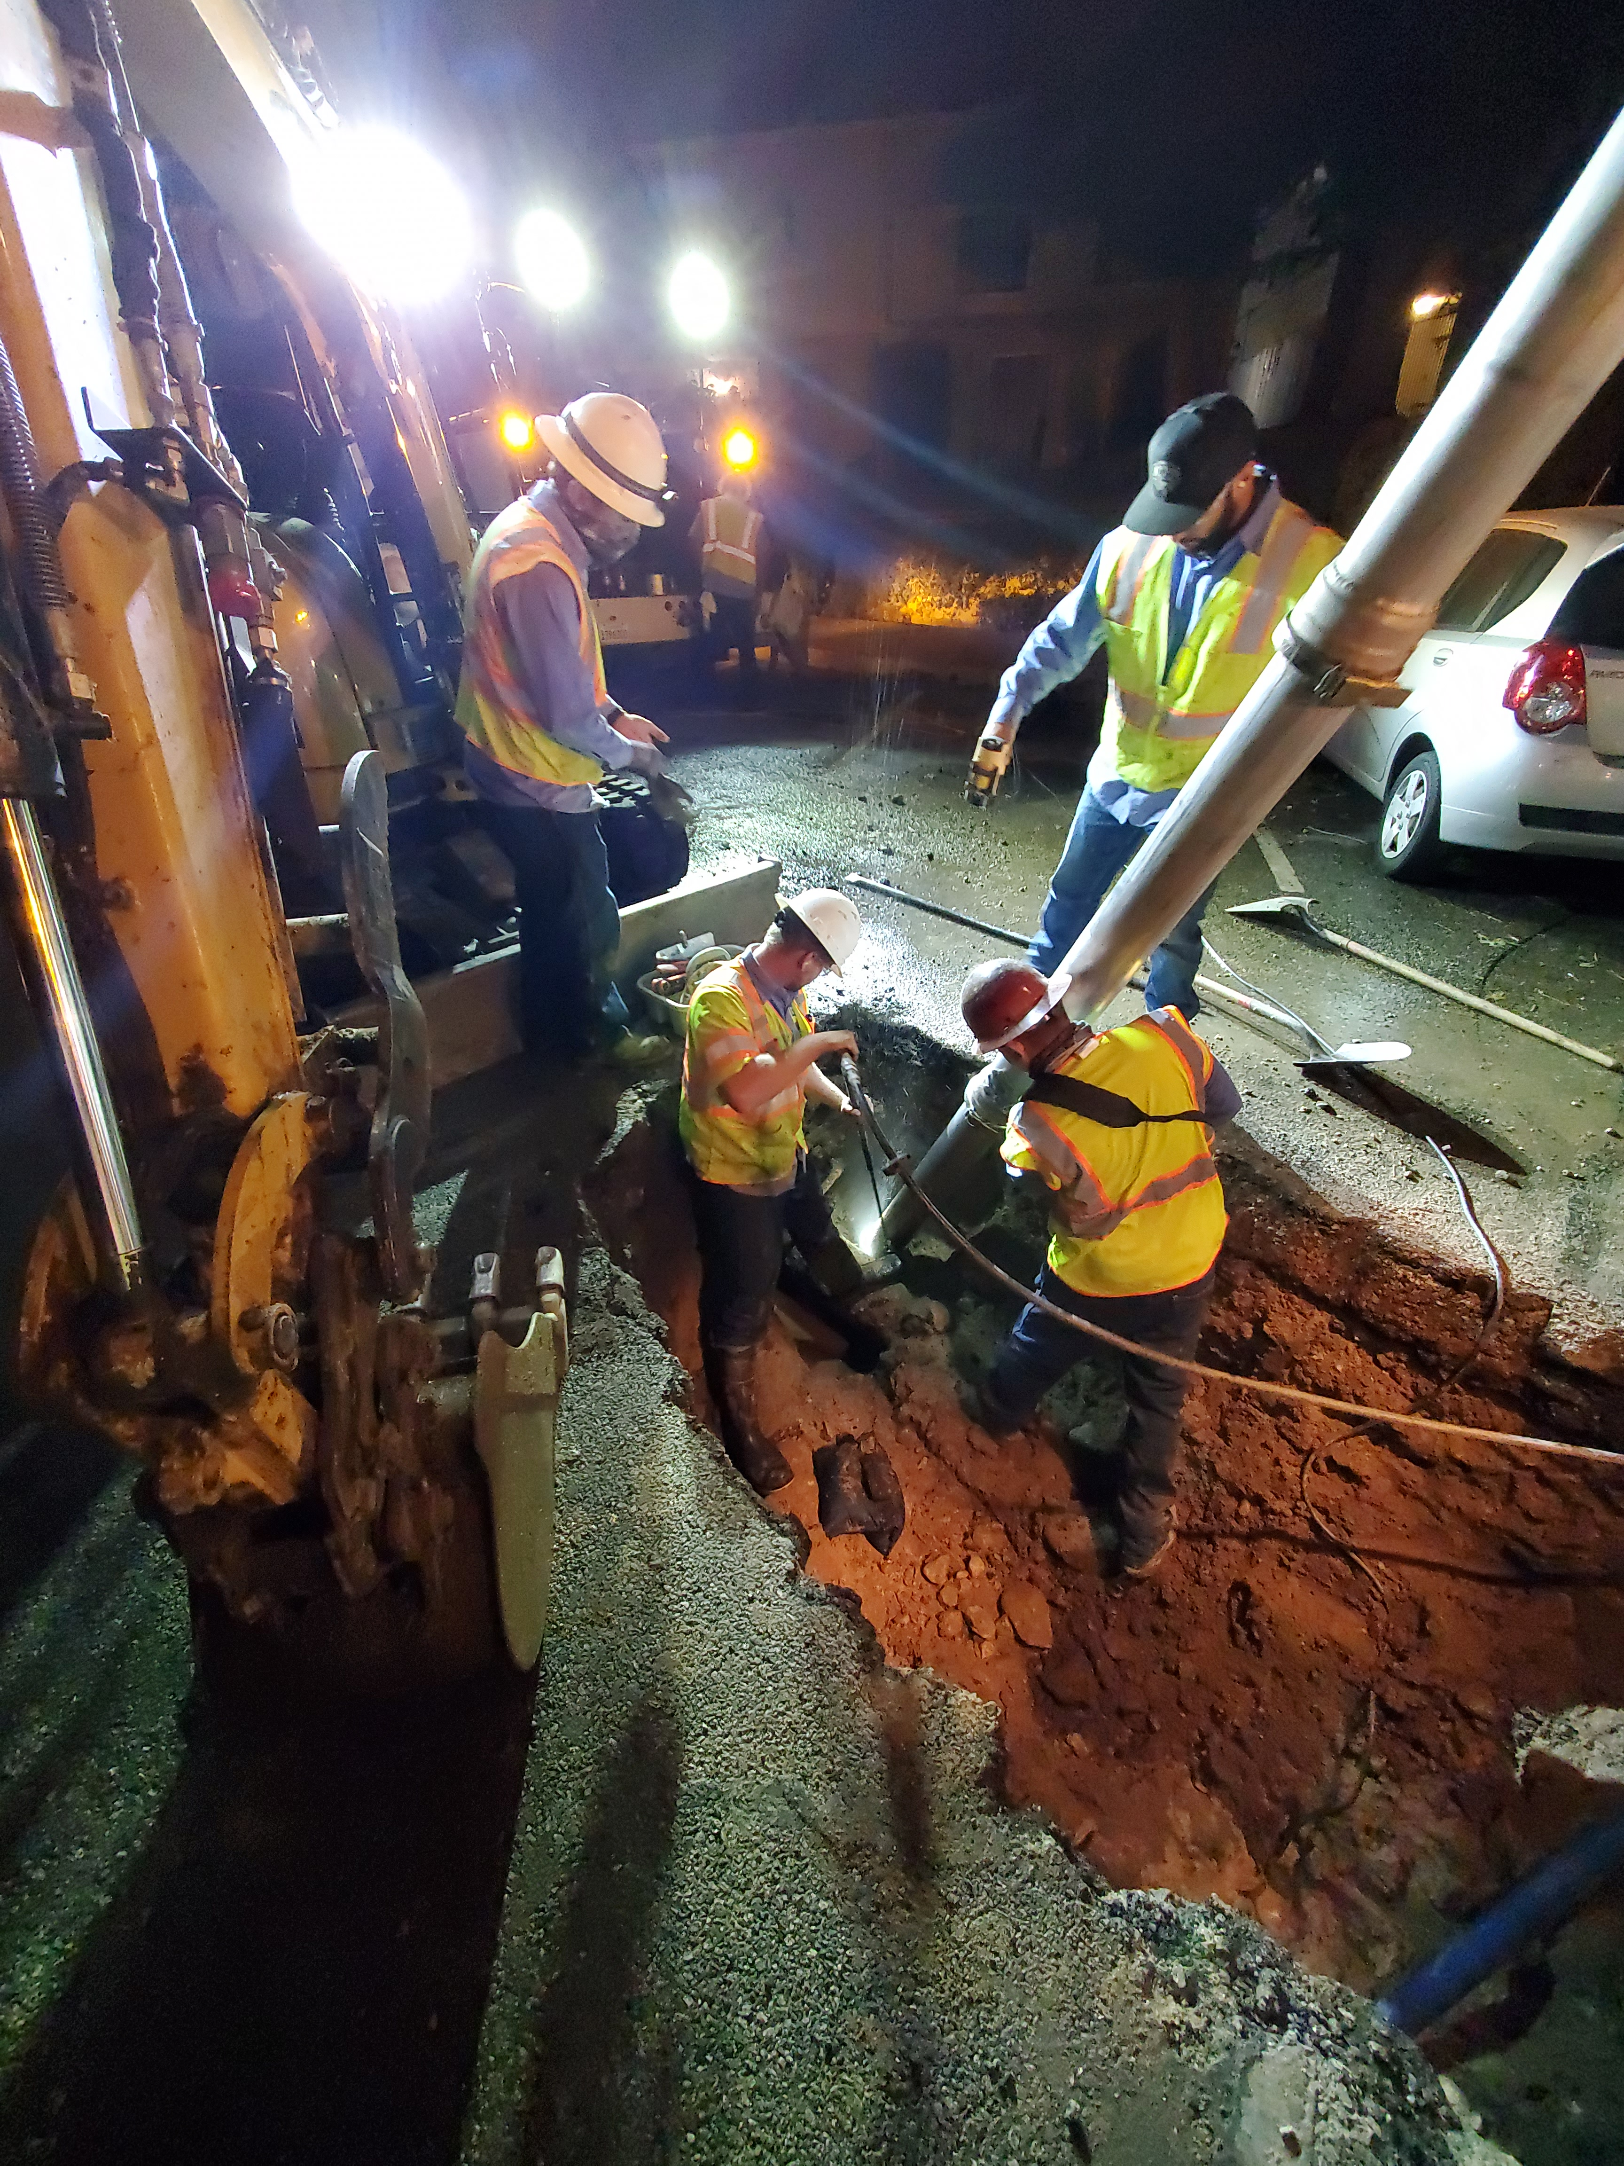
Opportunities
Rate Change – 8%, 7%, 7%, 7%, 6% over the next five fiscal years
  We made the hard decisions to raise the rates appropriately, but it was not enough
  If we don’t replace pipeline, we are not being proactive about maintenance. If we do, then we run entirely out of funds
Notes:
Opportunities
Rate Change – 8%, 7%, 7%, 7%, 6% over the next five fiscal years
We made the hard decisions to raise the rates appropriately, but it was not enough
If we don’t replace pipeline, we are not being proactive about maintenance. If we do, then we run entirely out of funds

Slide 25
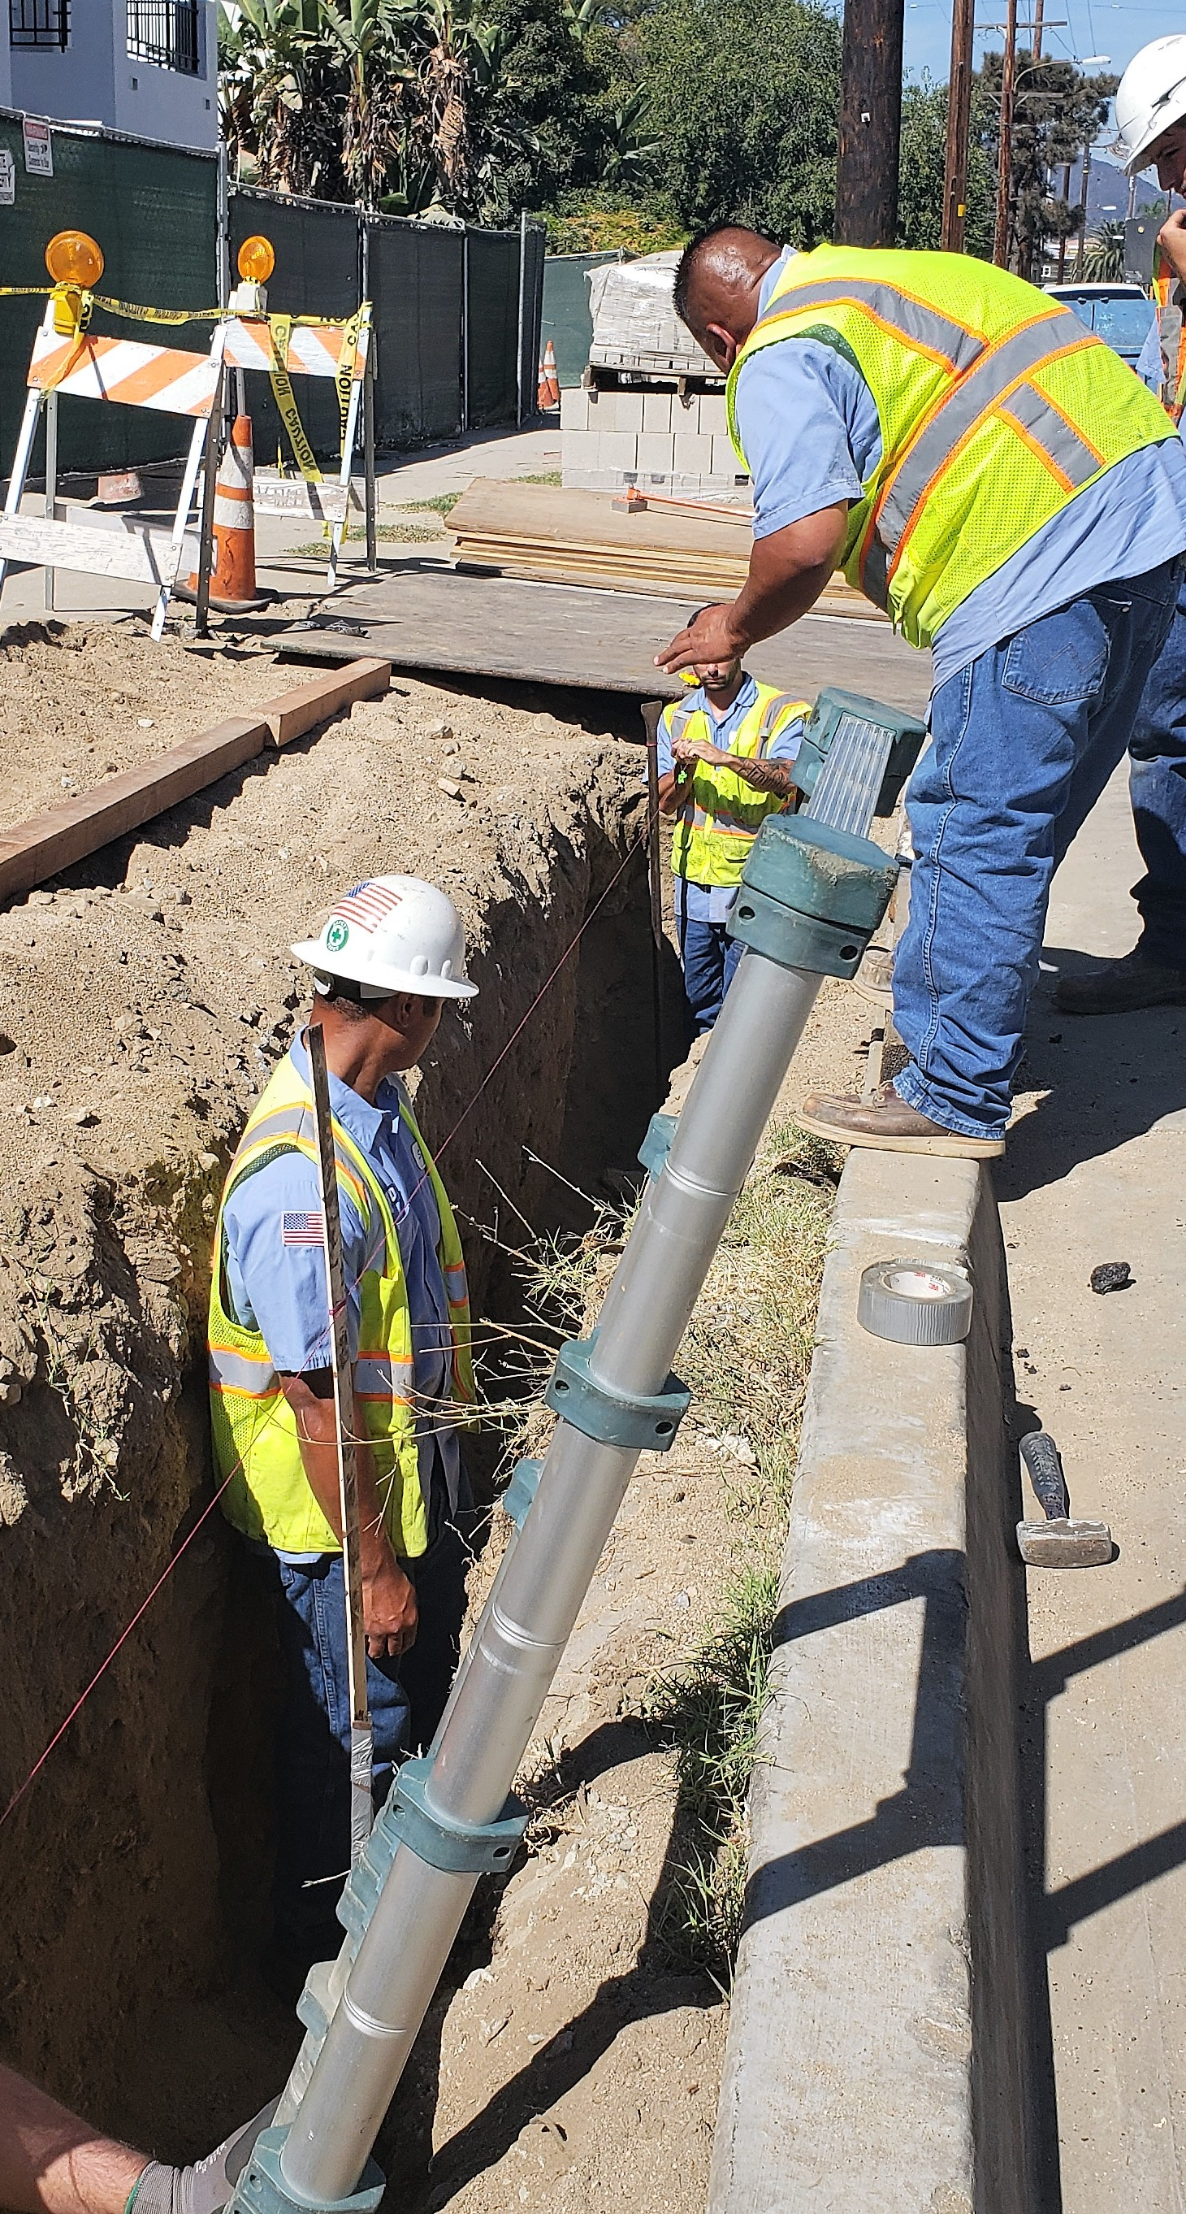
Dedicated Stream of Revenue
Assess a charge on the property roll
  Provides revenue stability while balancing equity
  Charges based on meter size capacity
  Supports pipeline replacement program
Notes:
With a dedicated stream, if anything, we can continue to support the backbone of our infrastructure and the primary component of property value and community stewardship
The District and the industry has always been subject to fluctuations in available funding because much funding is tied to water sales. The need for a reliable connection to the water system, however, shouldn’t depend on something that itself is dependent on things out of anybody’s control such as drought, precipitation, temperature etc.
Also, it is time for a paradigm shift – from viewing water as a commodity to viewing water as a service. Regardless of how much we use, we always have it available at the tap. Like a cable or cell phone bill
In fact, sewer bills have already been on the property roll for decades

Slide 26
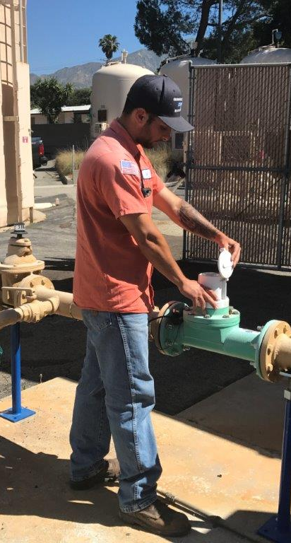
Rising ongoing costs
Operating Expenses
Labor
Capital Improvement Projects
Debt Service
Notes:
Operating Expenses: Costs to operate the district and support its daily
functions. Including many water quality tests, repairing leaks and
maintaining adequate water storage.
• Labor: Highly specialized staff to support CVWD daily operations,
customer services and emergency response.
• Capital Improvement Projects: Projects to improve and secure our
water infrastructure to maintain water quality, reliability and future needs.
• Debt Service: Costs to repay money borrowed to build existing and
future infrastructure.

Slide 27
Plan for the Future

Slide 28
Pipeline Replacement Requirements
Notes:
Updated Pipeline Replacement Requirements
The earlier years are lower because pipeline CIP has been deferred. We can look at the funding needs by average the next several years – either 3, 4, or 5-year averages
Talk about 1.25 (1.27 miles/year) target

Slide 29
Updated Pipeline Replacement Requirements
Notes:
Updated Pipeline Replacement Requirements
The earlier years are lower because pipeline CIP has been deferred. We can look at the funding needs by average the next several years – either 3, 4, or 5-year averages

Slide 30
Updated Pipeline Replacement Requirements
Notes:
Updated Pipeline Replacement Requirements
The earlier years are lower because pipeline CIP has been deferred. We can look at the funding needs by average the next several years – either 3, 4, or 5-year averages

Slide 31
Funding level options
Notes:
Which Level of Funding (The “why”, Part 2)
Goal(s) of section
Educate audience regarding: 1) current “200-year” pace; 2) Roadmap to get to “85-year” plan
Educate audience of rationale for: 1) calculation methodology; 2) level of funding (highest)
Educate audience of why the property roll (revenue stability)
Show 5-year pipeline CIP
We can choose “3-yr” / “4-yr” / “5-yr”
Show financial projections for each of three scenarios
3-yr – still very bad
4-yr – somewhat manageable
5-yr – puts us in a good place

Slide 32
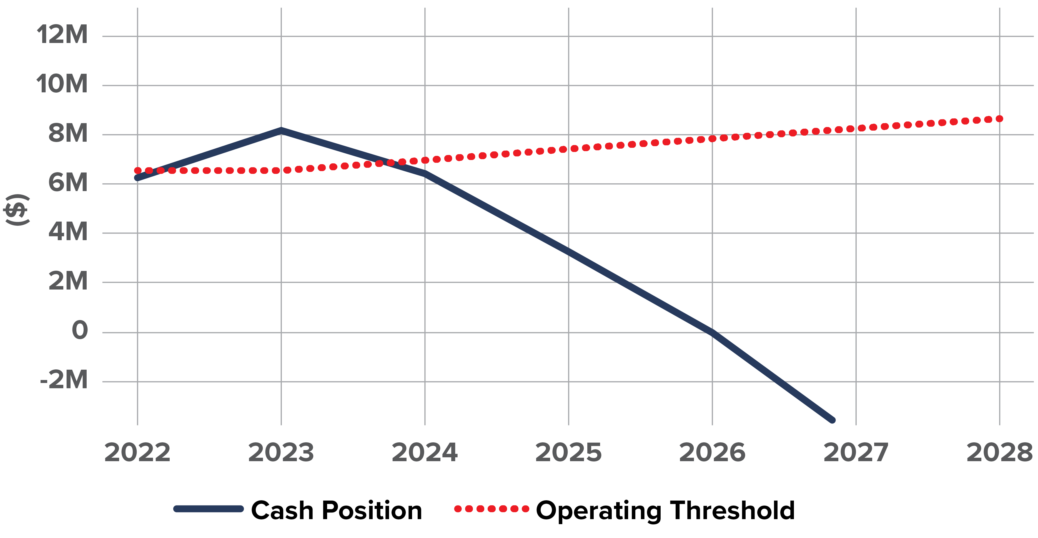
Funding level options
Status Quo
Fund pipelines but run out of money by 2026
Notes:
Which Level of Funding (The “why”, Part 2)
Goal(s) of section
Educate audience regarding: 1) current “200-year” pace; 2) Roadmap to get to “85-year” plan
Educate audience of rationale for: 1) calculation methodology; 2) level of funding (highest)
Educate audience of why the property roll (revenue stability)
Show 5-year pipeline CIP
We can choose “3-yr” / “4-yr” / “5-yr”
Show financial projections for each of three scenarios
3-yr – still very bad “significant funding gap still exists”
4-yr – somewhat manageable “less significant funding gap”
5-yr – puts us in a good place “meets funding requirements”

Slide 33
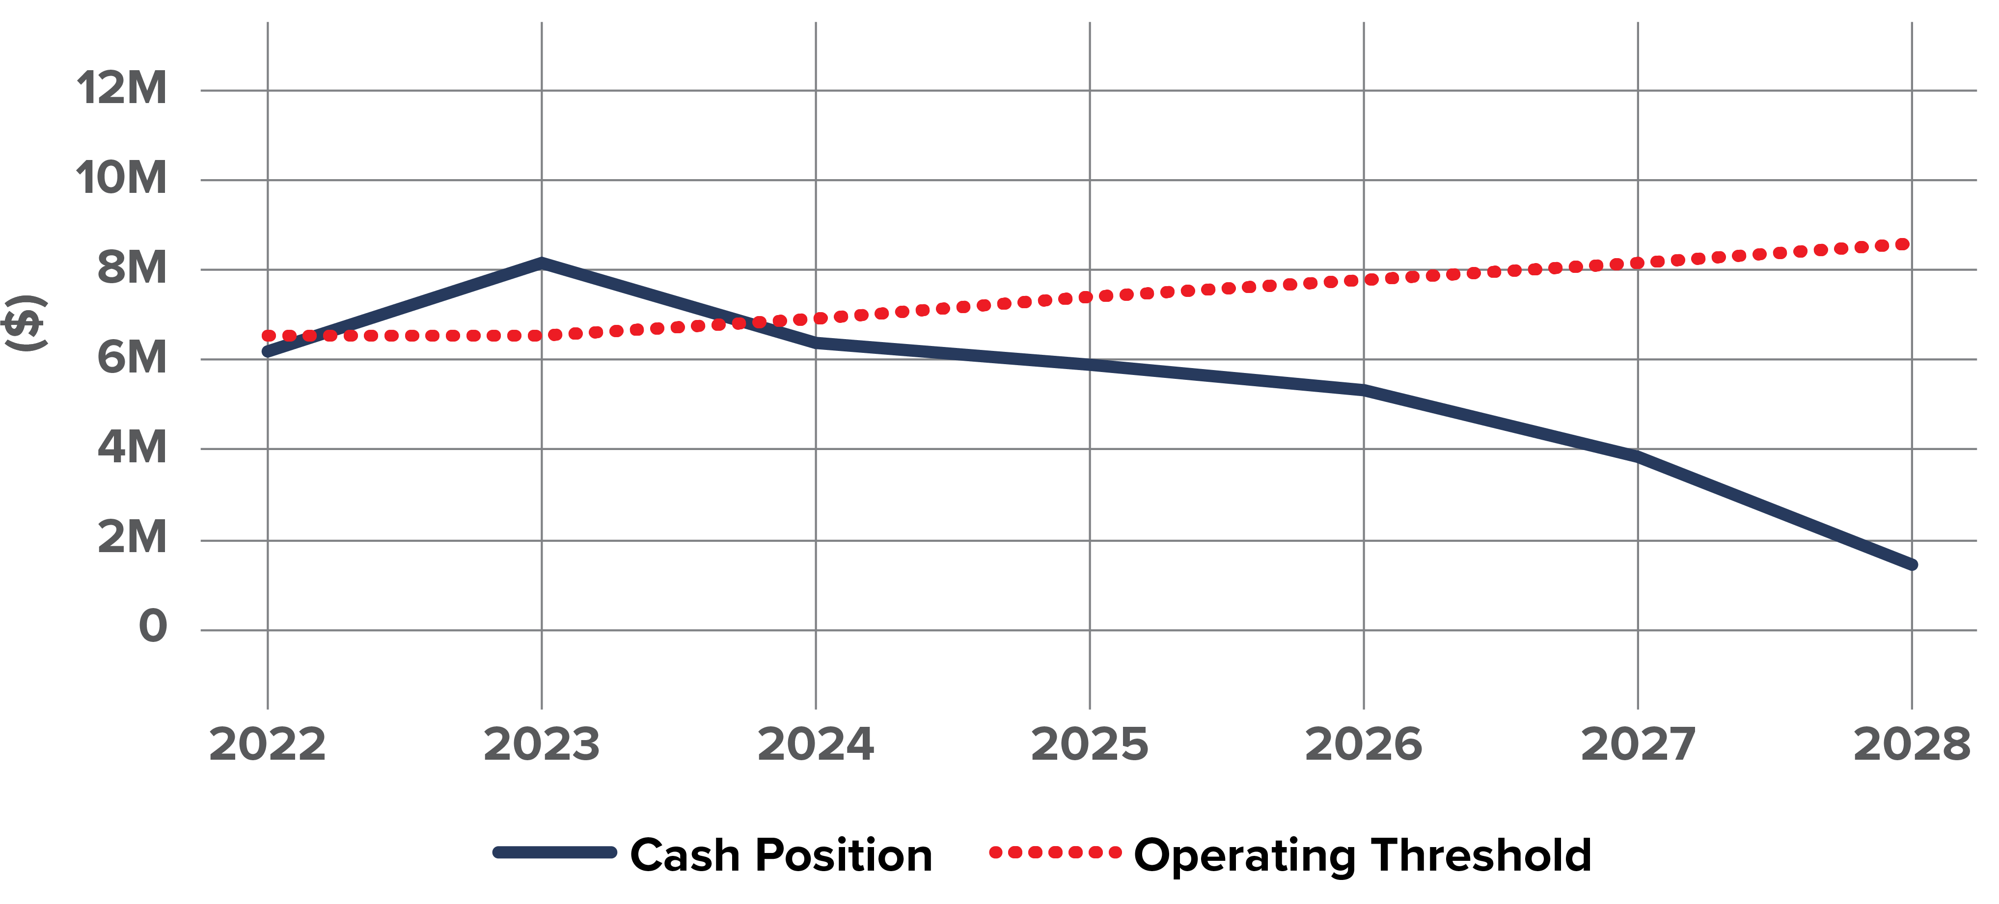
Funding level options
Based on 3-Yr Average
Significant funding gap persists
Notes:
Which Level of Funding (The “why”, Part 2)
Goal(s) of section
Educate audience regarding: 1) current “200-year” pace; 2) Roadmap to get to “85-year” plan
Educate audience of rationale for: 1) calculation methodology; 2) level of funding (highest)
Educate audience of why the property roll (revenue stability)
Show 5-year pipeline CIP
We can choose “3-yr” / “4-yr” / “5-yr”
Show financial projections for each of three scenarios
3-yr – still very bad “significant funding gap still exists”
4-yr – somewhat manageable “less significant funding gap”
5-yr – puts us in a good place “meets funding requirements”

Slide 34
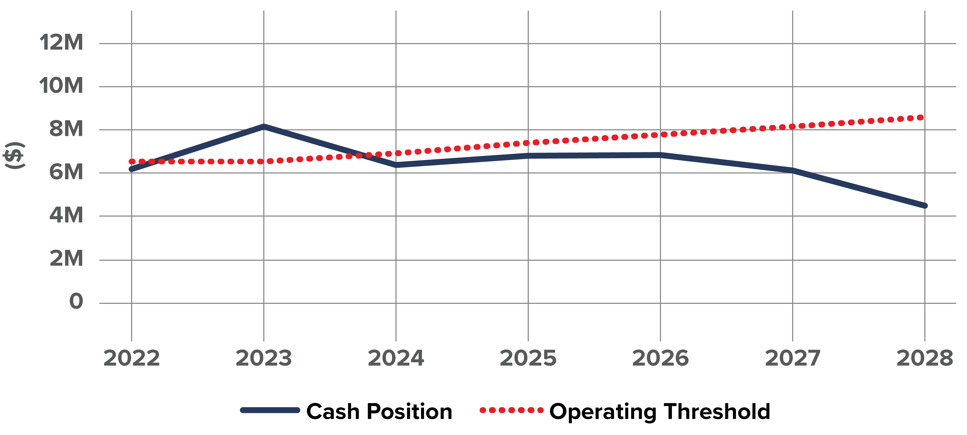
Funding level options
Based on 4-Yr Average
Less significant funding gap
Notes:
Which Level of Funding (The “why”, Part 2)
Goal(s) of section
Educate audience regarding: 1) current “200-year” pace; 2) Roadmap to get to “85-year” plan
Educate audience of rationale for: 1) calculation methodology; 2) level of funding (highest)
Educate audience of why the property roll (revenue stability)
Show 5-year pipeline CIP
We can choose “3-yr” / “4-yr” / “5-yr”
Show financial projections for each of three scenarios
3-yr – still very bad “significant funding gap still exists”
4-yr – somewhat manageable “less significant funding gap”
5-yr – puts us in a good place “meets funding requirements”

Slide 35
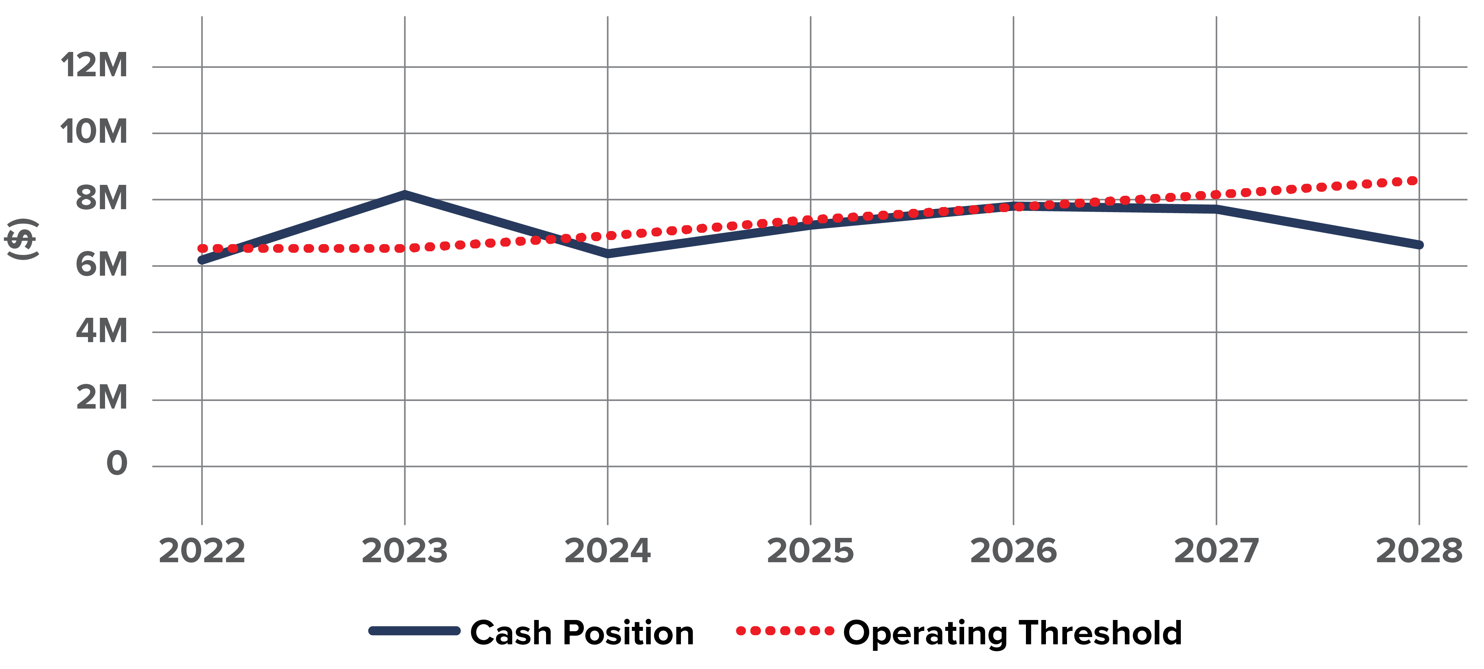
Funding level options
Based on 5-Yr Average
Funding requirements are met
Notes:
Which Level of Funding (The “why”, Part 2)
Goal(s) of section
Educate audience regarding: 1) current “200-year” pace; 2) Roadmap to get to “85-year” plan
Educate audience of rationale for: 1) calculation methodology; 2) level of funding (highest)
Educate audience of why the property roll (revenue stability)
Show 5-year pipeline CIP
We can choose “3-yr” / “4-yr” / “5-yr”
Show financial projections for each of three scenarios
3-yr – still very bad “significant funding gap still exists”
4-yr – somewhat manageable “less significant funding gap”
5-yr – puts us in a good place “meets funding requirements”

Slide 36
How does this affect me?
METER RATIOS
COMPARISON
Potable Meters
Meter | Number of Meters | AWWA Ratio
¾” | 7,044 | 1.00
1” | 885 | 1.67
1 ½” | 152 | 3.33
2” | 66 | 5.33
3” | 29 | 11.67
4” | 2 | 21.00
Meter | 3 Yr Avg | 4 Yr Avg | 5 Yr Avg
¾” | $273.62 | $351.94 | $404.30
1” | $456.03 | $586.57 | $673.83
1 ½” | $912.07 | $1,173.14 | $1,347.66
2” | $1,459.30 | $1,877.02 | $2,156.25
3” | $3,193.14 | $4,107.15 | $4,718.14
4” | $5,746.01 | $7,390.77 | $8,490.23
Notes:
How Does This Impact Me?
Goal(s) of section
Educate audience regarding: difference in charge based on meter size
Show that vast majority are at lowest price
Educate audience regarding property roll
Transparency with respect to “size” of charge comparable to other charges
Show comparison of charges for 3-yr vs 4-yr vs 5-yr
Show breakdown of meters (7K have the lowest fee)
Talk about what the property roll is and the various components (voter indebtedness vs. direct assessments)
Show two examples of property tax bills (one is an employee, one is a board member, one is a friend of mine)
Meter ratios represent the burden of that sized pipe on the system in relation to the “base” size. In our area, you can see the vast majority of customers are ¾”. 1” is typically newer, very large homes that also have high-capacity fire lines. 1.5+ meter sizes are typically HOA complexes and larger businesses like car washes

Slide 37
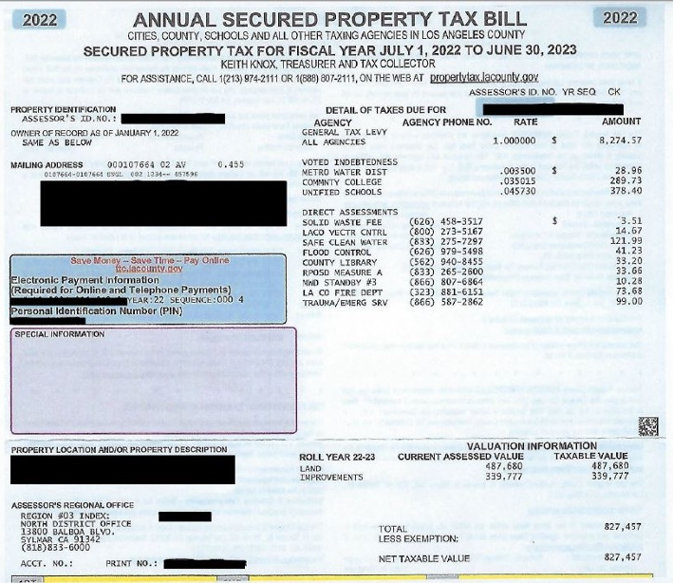
How will this appear on my property tax bill?
Notes:
Two examples of property tax bills, one is for an employee of ours and one is for a friend, both who volunteered their property tax statements (should we try to get one for a board member?). One has a lower Assessed Value and another has a higher AV.

Slide 38
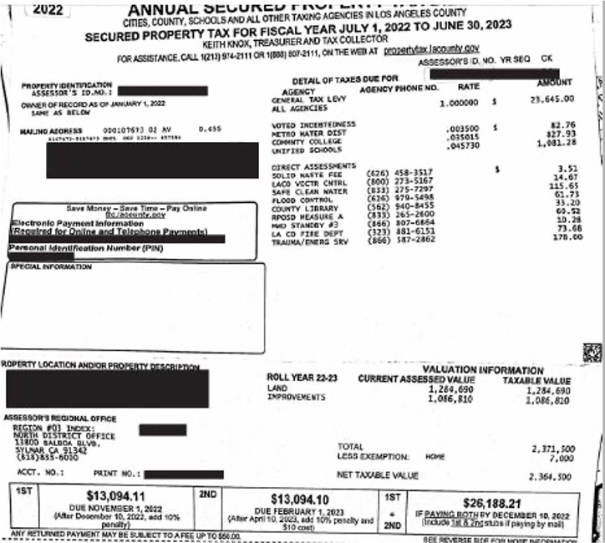
How will this appear on my property tax bill?

Slide 39
Next Steps

Slide 40

Share your Input
Upcoming Board meetings
  April 11 – determine revenue requirements and review draft of Prop 218
  April 25 – Approve Prop 218 notice
Develop “Bill Assistance Program” – enhance and expand existing Low-Income Program
Send Prop 218 notices
Public Hearing – June 13
Notes:
Next Steps
Goal(s) of section
Review next steps, reminding audience they are already engaged in the process
Introduce concept of “elevated” low-income program
Next steps – board meetings, 218 notice, public hearing etc
Include rate study, rate calculator, continued outreach etc
Low-Income program – Board has directed staff to look at ways to expand its low-income assistance program
Review next steps
Talk about how the Board is interested in expanding an existing program to encompass more of the community – decrease household income requirements / increase budget for program / increase level of assistance (currently 20% of bill)

Slide 41
Questions?
Notes:
Some questions to be ready for
Isn’t the drought over?
Why are pipelines so expensive?
Permitting, design, inspection etc
Didn’t you just pass three years of high rate increases? What gives?
Inflation – supplies, water, everything
Conservation (15% reduction in revenues)
Heightened urgency with events like Penn Ave and Ocean View
Have you pursued outside funding?
Yes, we get grants – AMI (large meters), wells (Well 2), LHMP (generators), wellness program (JPIA)
Why not bonds?
Yes considering
Hard to issue bonds if we don’t shore up at least a little bit
Probably want to wait since interest rates are high (we issued one in 2020 when it was 2.65%)
What does emergency planning look like?
What if you collect too much money. Will you lower our rates?
That would be something we consider
What have you done to save money?
A / b / c / d / e – internal jobs like oak creek, dunsmore channel / personnel management (temps and LTEs)
How are you preparing for the recession?
Where’s AMI? You guys have been promising this for years
Won’t this arrangement increase the amount of “fixed” revenue you collect?
How much are we charging: Multi-Family? How does that work? How about large accounts like CalTrans?
How did you derive the cost of pipeline replacement projects, since this is the root basis of your costs you’re trying to fund?

Slide 42
Contact Us
customerservice@cvwd.com
818-248-3925
www.cvwd.com

